Slide 1
Reflective scattering at the LHC
Sergey Troshin, IHEP, Protvino, Russia.
Based on the below recent papers:
Is elastic scattering at the LHC absorptive or geometric?
S.M. Troshin, N.E. Tyurin,
Phys.Rev. D88 (2013) 077502
Impact-parameter analysis of TOTEM data at the LHC:
Black disk limit exceeded
A. Alkin, E. Martynov, O. Kovalenko, S.M. Troshin,
Phys.Rev. D89 (2014) 091501(R)
Slow down of the mean multiplicity growth at the LHC
S.M. Troshin, N.E. Tyurin,
Phys.Lett. B732 (2014) 95.

Slide 2
Motivation
To search (at the LHC and cosmic rays) for a new reflective scattering mode based on the saturation of the unitarity relation, when elastic scattering not only survives, but prevails at super high energies in hadron collisions at small impact parameter values.

Slide 3
Prehistory
Self-damping of inelastic channels: M.Baker, R. Blankenbecler, 1962
Absorption does not result from unitarity: C.T. Sachrajda, R. Blankenbecler, 1975
Antishadowing in the context of rising cross-sections: S.T., N.E. Tyurin, 1993
Antishadowing as reflective scattering: S.T., N.E. Tyurin, 2007

Slide 4
Unitarity
Two solutions for the pure imaginary amplitude

Slide 5
Selection of one solution
Let
be small
The apparent reason to neglect solution of unitarity with “+”

Slide 8
Reflection (general formulae)

Slide 9
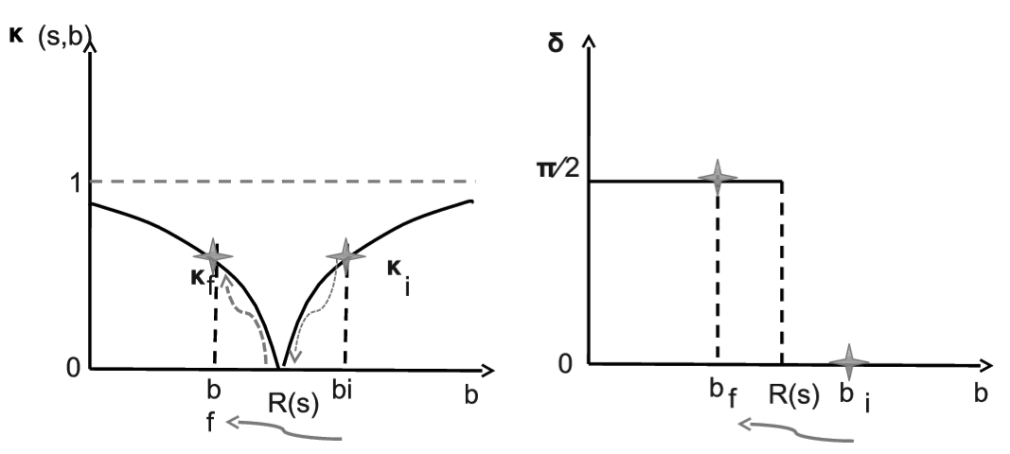

Slide 10
S-matrix representation (S is an elastic scattering element of the S-matrix.)
One-to-one transform
-1
1
0

Slide 11
Pure imaginary U-matrix
Reflective scattering

Slide 12
Optical analogy
Analogy with the light reflection off a dense medium, the phase of the reflected light is changed by 180º. With this optical concept, the above behavior of S(s,b) should be interpreted as appearance of a reflecting ability of scatterer due to increase of its density beyond some critical value.

Slide 13
Exponential form
Exponential and rational forms provide
for any finite value of
-1
1
0

Slide 14
Various models (Regge-type, geometrical…):
Black disk

Slide 15
Geometric picture
The generic geometric picture at fixed energy beyond the black disc limit can be described as a scattering off the partially reflective and partially absorptive disk surrounded by the black ring which becomes grey at larger values of the impact parameter.
The evolution with energy is characterized by increasing albedo due to the interrelated increase of reflection and decrease of absorption at small impact parameters.

Slide 16
Phenomenology

Slide 20
Effects for multiparticle production
Slowing down the mean multiplicity growth
c

Slide 21
Conclusion
Various underlying microscopic mechanisms related to the collective quark-gluon dynamics in head-on collisions can be envisaged as the origin of the reflection phenomenon.
Appearance of the reflection, however, at very high energies is not directly dictated by any specific dynamics, it is a result of S-matrix unitarity saturation related to the total cross section growth.
First indication of the reflective mode has been found in the TOTEM data at 7 TeV
New measurements at higher energies would be decisive

Slide 22
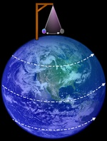
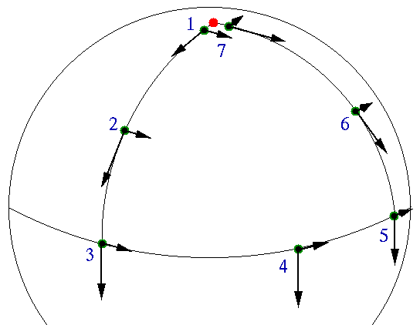
Backup slides:
Classical examples

Slide 23

Geometric phase and
Geometric Quantum Computation.
Angelo Carollo
a.carollo@imperial.ac.uk

Slide 24
Physical meaning?
Suppose that an Hamiltonian H(r) depends on a set of parameters
For each value of r, the following eigenvalue equation is valid:
If the parameters r change slowly in time, the adiabatic theorem assures that the system remains in the eigenstate of the Hamiltonian, i.e.
What if for some value of t=T: r(T)=r(0)? (Cyclic evolution)
Certainly:

Slide 25
Berry phase
M. Berry, Proc. Roy. Soc. A 392, 45 (1984)
Then the state returns to its initial form but since eigenstates are defined up to a phase factor, the state could acquire a phase due to the adiabatic and cyclic evolution that took place.
dynamical phase
Geometrical phase: It is the same expression derived before for a general curve.

